Slide 1
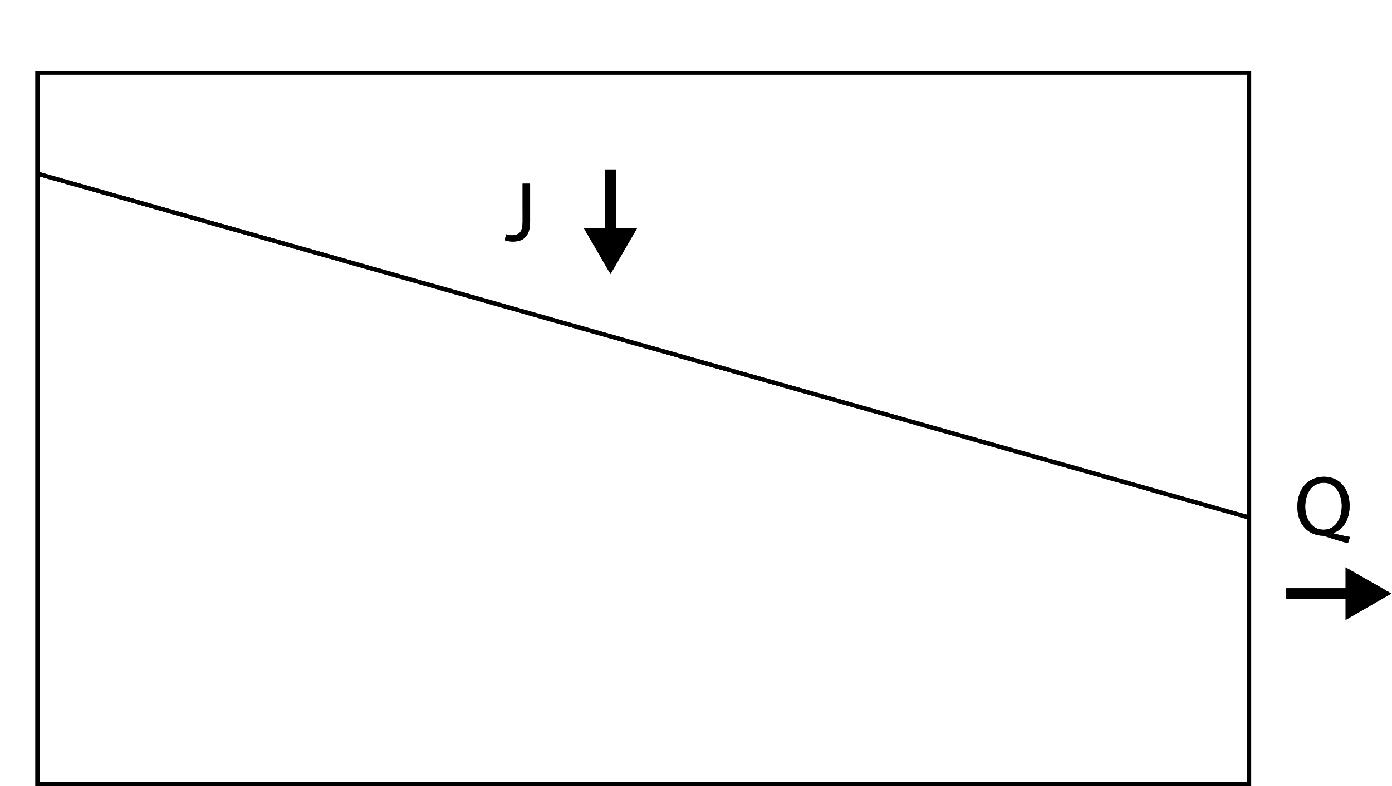
SAS FUNCTION
Ω_{Q} [-]
SAS function
S_{T} [mm]
Q
P_{Q} [-]
Transit time distribution
Hillslope
T [day]
Notes:
As you can see, the SAS function is much smoother and does not have the flat areas, while it does in the cumulative TTD.

